Slide 1


UNIVERSIDAD AUTÓNOMA DEL ESTADO DE HIDALGO
ESCUELA SUPERIOR DE ZIMAPÁN
Licenciatura en Contaduría
Tema: Making comparisons
L.E.L.I. Paulina Trujillo Castillo
Enero – Junio 2014

Slide 2
Tema: Making comparisons
Resumen (Abstract)
We use comparatives to compare two nouns which belong (most of the times) to the same group or to groups of nouns which have some characteristics in particular which can be compared.
Usamos los comparativos para comparar dos sustantivos que pertenecen (la mayor parte del tiempo) al mismo grupo o a grupos de sustantivos que tienen algunas características particulares que pueden ser comparadas.

Slide 3
Palabras clave: (keywords)
Adjective, syllable, ending, more, less, as…as.
Adjetivo, sílaba, terminación, más, menos, tan … como.

Slide 4
Objetivo general:
El alumno podrá expresar eventos, sueños, expectativas y ambiciones, y de manera breve dar su opinión acerca de planes futuros, preferencias. El alumno podrá describir experiencias y eventos sucedidos en un pasado indefinido acerca de temas comunes en contextos tales como el trabajo, la escuela, y de esparcimiento; estableciendo la duración de los mismos.
El alumno podrá expresar la duración de eventos y su propósito.

Slide 5
Nombre de la unidad:
UNIDAD I: xxx
Objetivo de la unidad:
El alumno será capaz de comparar sustantivos de manera más compleja y podrá llevar a cabo una conversación en el teléfono.

Slide 6
Tema:
2.1 Comparar dos sustantivos que pertenecen al mismo grupo.
Introducción:
It is very usual to make comparisons about the things around us, or even people.
We sometimes want to ay something or someone is more or less than anything else, and in order to do that, we can use the grammar rules to make comparatives.

Slide 7
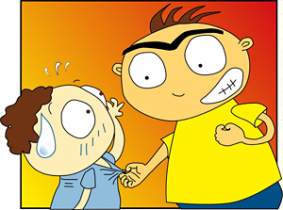
Desarrollo del Tema:
We use comparatives to compare two people or things that are different.
Harry’s more
Aggressive
Than tom.

Slide 8
To make comparatives, we shall use the following chart:
Type of adjective | Spelling rule | Comparative
Most 1 syllable adjectives | Add –er | Older Brighter But! Dry = drier
1 syllable adjectives ending in –e | Add –r | Nicer Safer
1 syllable adjectives ending in consonant + vowel + consonant | Double the last consonant and –er | Bigger Fatter But! New = newer
2 syllable adjectives ending in –y | -y -i and add –er | Easier Noisier
2 syllable adjectives not ending in –y | Put more before the adjective | More mature More patient
Adjectives with 3 syllables or more | Put more before the adjective | More aggressive More organised
Irregular adjectives | Good Bad Far Little | Better Worse Farther Less

Slide 9
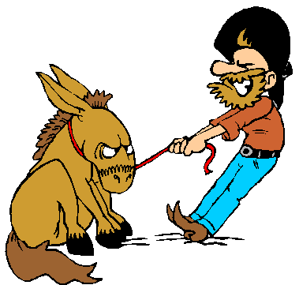
The opposite of more is less.
He’s less stubborn than
his brother.

Slide 10
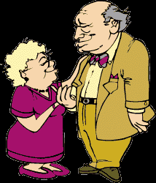
When we compare two things in the same sentence, we use than after the comparative.
Tom is two years older
than Sally.

Slide 11

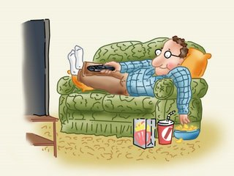
We use a lot or much before the comparative to say there’s a big difference.
He’s much
lazier.
He’s a lot
noisier.

Slide 12
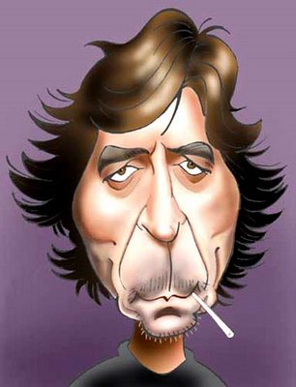
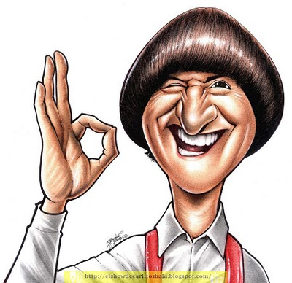
We use a bit before the comparative to say there’s a small difference.
Who’s a bit more
handsome?

Slide 13
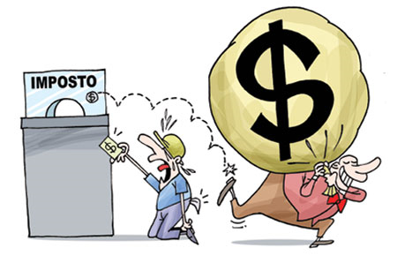
Tip!
We can also use more with nouns.
He’s got more money than him.

Slide 14

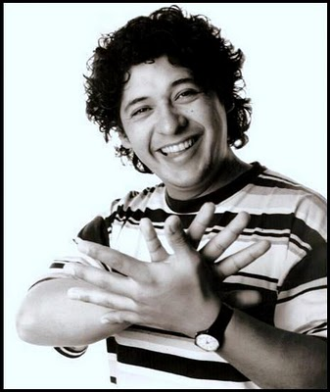
(Not) as + adjective + as
We can also use not as + adjective + as to compare two people or things that are different.
Harry isn’t as happy as Tom

Slide 15
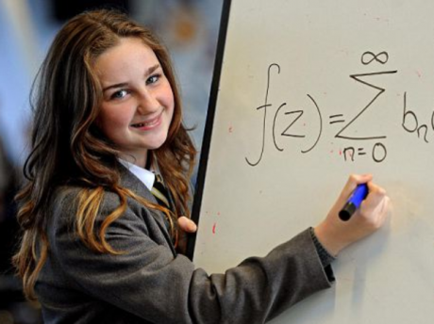

We use as + adjective + as to say that two people or things are the same.
Lisa’s as clever
as Milton.
= They are both equally intelligent.

Slide 16
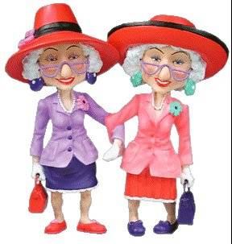
We use the adjective with (not) as … as, not the comparative form.
She’s as old as me.

Slide 17

We don’t use than with (not) as…as.
She isn’t as quiet as my other nieces.

Slide 18
As a conclusion, it is important to establish that to make comparisons, it will always be important to consider that both nouns we are comparing must belong to the same group.

Slide 19
Bibliografía del tema:
Redston, C. Cunningham, G. (2005). Face2Face Pre-Intermediate Student’s Book. Cambridge, London. Cambridge University Press.
Redston, C. Cunningham, G. (2005). Face2Face Pre-Intermediate Workbook. Cambridge, London. Cambridge University Press.
Redston, C. Cunningham, G. (2005). Face2Face Pre-Intermediate Teacher’s Book. Cambridge, London. Cambridge University Press.
Evans, V. Dooley, J. (2002).Enterprise Coursebook 2.Newbury, Berkshire. Express Publishing.
Evans, V. Dooley, J. (2002).Enterprise Workbook 2.Newbury, Berkshire. Express Publishing.

